Slide 1
Targets Affecting Cellular Communication and Survival: RAS, BRAF, MAPK, and HER2
Alaa Soboh
MD, Medical Oncology

Slide 2
Patient Case
A 64-yr-old female patient is diagnosed with stage IV descending colon cancer with synchronous unresectable liver, lung, peritoneal, and retroperitoneal metastases
She has a good performance status but has back and RUQ pain for which she receives opioids
She has no signs of bowel obstruction

Slide 3

What Influences Treatment Choices in mCRC?
Patient characteristics
Molecular characteristics
Comorbidities
Prior adjuvant treatment
RAS
BRAF
1L
Age
Performance status
MSI-high
HER2
2L
Tumor characteristics
Patient preference
3L
Tumor burden
Resectability
4L
Quality
of life
Toxicity
profile
Tumor location
Therapy tailored according to individual patient needs
Slide credit: clinicaloptions.com
Notes:
mCRC, metastatic colorectal cancer.

Slide 4
Case 1: Results of Biomarker Testing
Standard IHC screening for MMR protein expression reveals absence of MLH-1
Subsequent MSI-testing qualifies the cancer as MSI-H
Further workup identifies a BRAF V600E mutation in the cancer tissue
No RAS mutation or HER2 amplification is found
Slide credit: clinicaloptions.com
Notes:
IHC, immunohistochemistry; MMR, mismatch repair; MSI, microsatellite instability.

Slide 5
The “Perfect” Candidate for Treatment With First-line EGFR Antibodies
Negative selection (mutually exclusive)
KRAS/NRAS/HRAS exon 2, 3, 4 wild type - 55%
No BRAF V600E mutation - 8%
(No HER2 amplification -2.5%)
Further exclusion criteria (not mutually exclusive)
Right-sided cancers 30%
Slide credit: clinicaloptions.com

Slide 6
BRAF

Slide 7
FDA-Approved Indications for BRAF Inhibitors
Dabrafenib
Trametinib
Encorafenib + binimetinib
Unresectable or metastatic melanoma with BRAF V600E^{[1]}
Unresectable or metastatic melanoma with BRAF V600E or BRAF V600K^{[2]}
Unresectable or metastatic melanoma with BRAF V600E or BRAF V600K^{[5,6]}
Dabrafenib + trametinib
Vemurafenib
Adjuvant treatment for melanoma with BRAF V600E or BRAF V600K and LN involvement after complete resection^{[1,2]}
Unresectable or metastatic melanoma with BRAF V600E or BRAF V600K^{[1,2]}
Metastatic NSCLC with BRAF V600E^{[1,2]}
LA or metastatic anaplastic thyroid cancer with BRAF V600E and no locoregional treatment options^{[1,2]}
Unresectable or metastatic melanoma with BRAF V600E^{[3]}
Erdheim-Chester disease with BRAF V600E ^{[3]}
Vemurafenib + cobimetinib
Unresectable or metastatic melanoma with BRAF V600E or BRAF V600K^{[3,4]}
1. Dabrafenib PI. 2. Trametinib PI. 3. Vemurafenib PI. 4. Cobimetinib PI. 5. Encorafenib PI. 6. Binimetinib PI.
Slide credit: clinicaloptions.com
Notes:
LA, locally advanced; LN, lymph node.

Slide 8
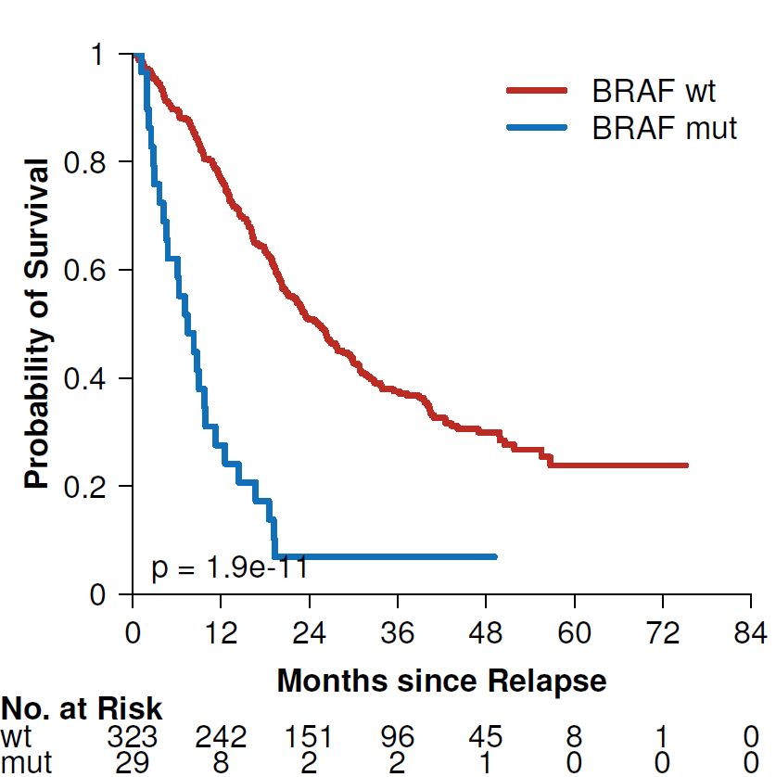
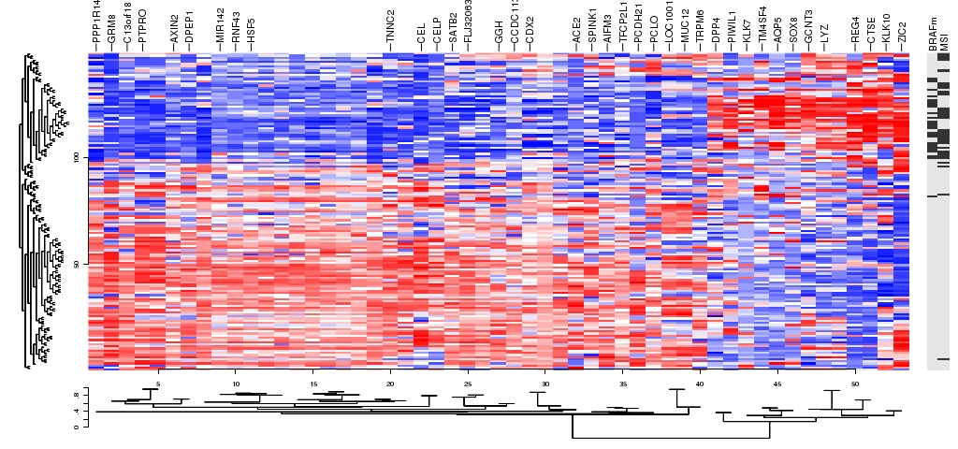
PETACC-3 Adjuvant 5-FU/LV ± Irinotecan in CRC:
OS After Relapse According to BRAF Mutation Status
100
80
BRAF mut
Median OS, Mos
Mutated BRAF: 7.49
Wild-type BRAF: 25.2
P = 1.9e-11
60
OS, %
BRAF wildtype
40
20
Tejpar. ASCO 2010. Abstr 3505. Roth. JCO. 2010;28:466.
Slide credit: clinicaloptions.com
Notes:
5-FU/LV, 5-fluorouracil / leucovorin; CRC, colorectal cancer.

Slide 9
S1406: PFS With Cetuximab + Irinotecan ± Vemurafenib
100
Events, n mPFS (95% CI)
40 4.3 (3.6-5.7)
48 2.0 (1.8-2.1)
Vemurafenib + cetuximab + irinotecan
80
Cetuximab + irinotecan
HR: 0.48 (95% CI: 0.31-0.75; P = .001)
60
PFS (%)
Median follow-up: 7.3 mos
48% of patients crossed over to VIC after PD on IC; median PFS: 5.8 mos
40
20
0
0
3
6
8
10
12
14
Mos
Kopetz. ASCO 2017. Abstr 3505.
Slide credit: clinicaloptions.com
Notes:
IC, irinotecan, cetuximab; m, median; MSS, microsatellite stable; PD, progressive disease; VIC, vemurafenib, irinotecan, cetuximab.

Slide 10


S1406: ORR, OS With Cetuximab + Irino ± Vemurafenib
Cetuximab + Irinotecan
100%
4%
OS (mos)
20%
0%
N Median 95% CI
Cetuximab + irinotecan 50 5.9 (3.0-9.9)
Vemurafenib + cetuximab 49 9.6 (7.5-13.1)
+ irinotecan
-30%
DCR 22%
-100%
Vemurafenib + Cetuximab + Irinotecan
100%
HR: 0.73 (95% CI: 0.45-1.17; P = .19)
16%
20%
0%
-30%
DCR 67%
-100%
Kopetz. ASCO 2017. Abstr 3505.
Slide credit: clinicaloptions.com
Notes:
DCR, disease control rate.

Slide 11
BEACON CRC: Encorafenib/Cetuximab ± Binimetinib vs Cetuximab/Chemotherapy in BRAF+ Metastatic CRC
Randomized, open-label phase III trial
Binimetinib 45 mg BID
Encorafenib 300 mg QD
Cetuximab 400 mg/m² →
250 mg/m² QW
(n = 205)
Safety Lead-in
Patients with BRAF V600E+ mCRC with PD on 1-2 regimens (no prior RAF/MEK/EGFRi);
no symptomatic brain mets
(N = 30 in safety lead-in; planned N = 645)
Binimetinib 45 mg BID
Encorafenib 300 mg QD
Cetuximab 400 mg/m² → 250 mg/m² QW
Patients followed for OS beyond progression
Encorafenib 300 mg QD
Cetuximab 400 mg/m² →
250 mg/m² QW
(n = 205)
N = 30
Investigator’s Choice
FOLFIRI/Cetuximab or
Irinotecan/Cetuximab
(n = 205)
Van Cutsem. JCO. 2019;[Epub]. NCT02928224
Slide credit: clinicaloptions.com
Notes:
AE, adverse event; CRC, colorectal cancer; DLT, dose-limiting toxicity

Slide 12
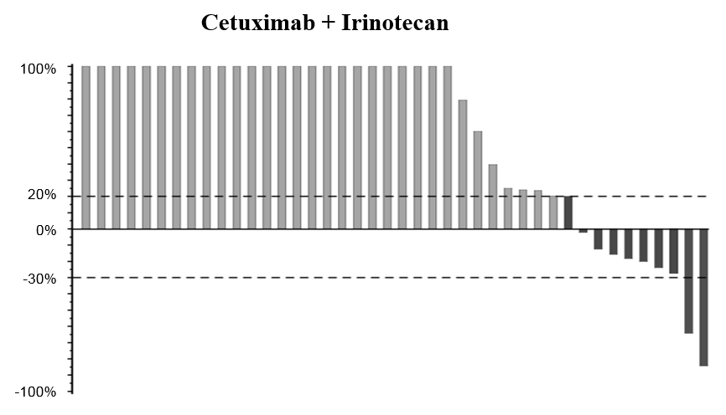
Encorafenib, Cetuximab, + Binimetinib in BRAF+ mCRC: Tumor Change in BEACON CRC SLI Phase^{[1]}
100
Cetuximab + Irinotecan from SWOG S1406^{[2]}
80
CR (n = 3)
PR (n = 11)
Other (n = 14)
60
40
20
Best Change From Baseline (%)
0
-20
-40
-60
ORR: 48%
Median PFS: 8.0 mos
-80
-100
Patients
1. Van Cutsem. JCO. 2019;[Epub]. 2. Kopetz. ASCO 2017. Abstr 3505.
Slide credit: clinicaloptions.com
Notes:
CRC, colorectal cancer; SLI, safety lead-in.

Slide 13
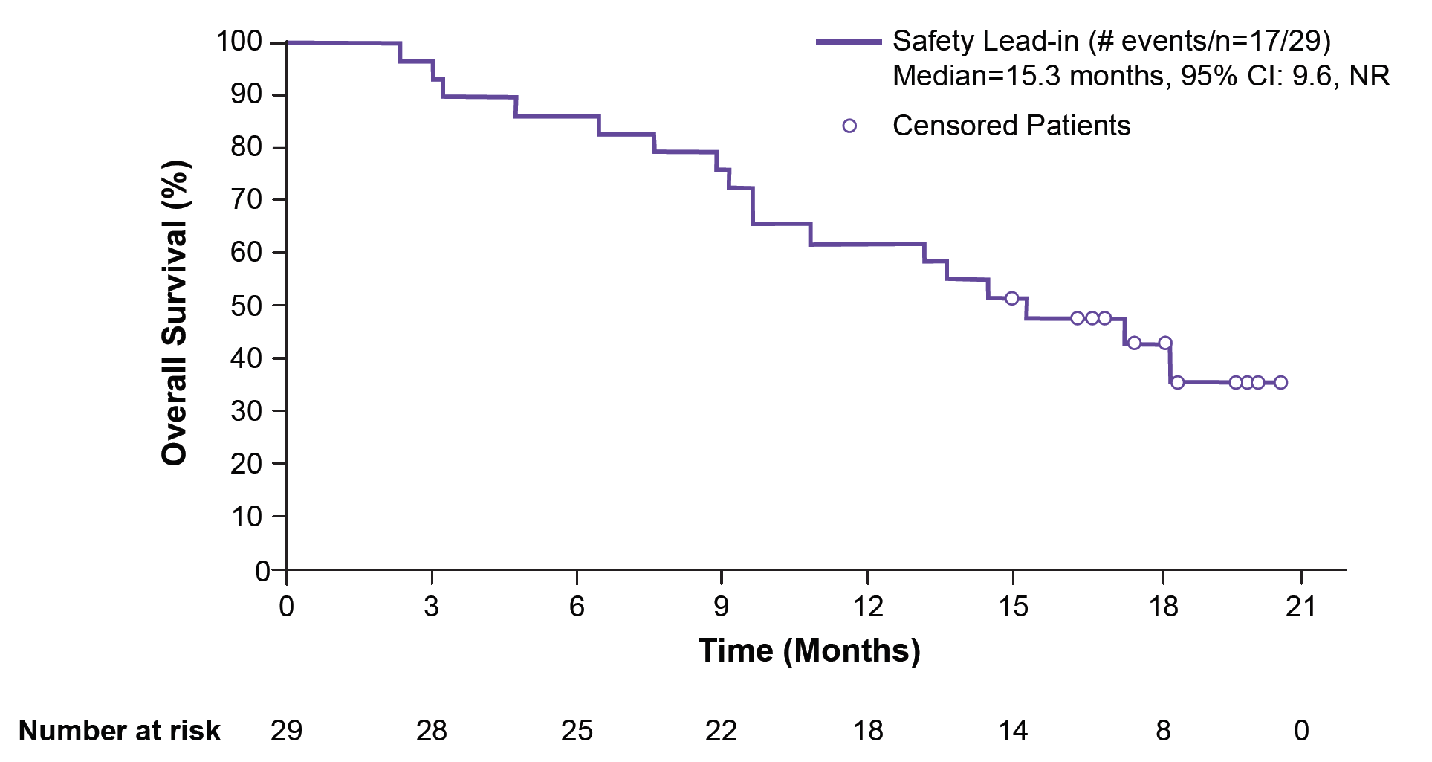
Encorafenib, Cetuximab, + Binimetinib in BRAF+ Metastatic CRC: OS in BEACON CRC SLI Phase
Safety Lead-in (# events/n=17/29)
Median=15.3 months, 95% CI: 9.6, NR
Censored Patients
Safety Lead-in (events/N = 17/29)
Median OS: 15.3 months (95% CI: 9.6-NR)
OS, % | 1 Prior Regimen | 2 Prior Regimens
6 mos | 88 | 85
12 mos | 63 | 62
Current guidelines: Category 2A recommendation since 3/19
Van Cutsem. JCO. 2019;[Epub].
Slide credit: clinicaloptions.com
Notes:
CRC, colorectal cancer; SLI, small lead-in.

Slide 14
Encorafenib, Cetuximab, + Binimetinib in BRAF+ Metastatic CRC: AEs in BEACON CRC SLI Phase
Adverse Event in ≥ 20% of Pts with Any Grade or ≥ 10% of Pts with Grade 3/4, n (%) | Any Grade | Grade 3/4
Diarrhea | 23 (77) | --
Dermatitis acneiform | 20 (67) | --
Fatigue | 19 (63) | 4 (13)
Nausea | 19 (63) | 2 (7)
Vomiting | 15 (50) | 2 (7)
Dry skin | 15 (50) | --
Anemia | 12 (40) | 3 (10)
Decreased appetite | 12 (40) | 2 (7)
Abdominal pain | 11 (37) | --
Increased creatinine kinase | 11 (37) | 3 (10)
Pyrexia | 11 (37) | --
Dyspnea | 10 (33) | 2 (7)
Constipation | 9 (30) | --
Arthralgia | 8 (27) | --
Creatine increased | 8 (27) | --
Skin fissure | 8 (27) | --
Vision blurred | 8 (27) | --
Increased aspartate aminotransferase | 6 (20) | 3 (10)
Asthenia | 6 (20) | --
Malaise | 6 (20) | --
Myalgia | 6 (20) | --
PPED syndrome | 6 (20) | --
Rash maculopapular | 6 (20) | --
Urinary tract infection | 5 (17) | 3 (10)
Van Cutsem. JCO. 2019;[Epub].
Slide credit: clinicaloptions.com
Notes:
AE, adverse event; CRC, colorectal cancer; PPED, palmar-plantar erythrodysesthesia; SLI, small lead-in.

Slide 15
BEACON Press Release May 21, 2019
 | ORR,† % |  | OS, Mos
N | 331 |  | 665
Triplet | 26.1 |  | 9.0
Control | 1.9 |  | 5.4
Doublet | 20.4 |  | 8.4
Triplet ORR
Second line: 34.3%
Third line: 22.4%
HR: 0.52
P < .0001
P < .0001
HR: 0.79
P = .116*
P < .0001
HR: 0.60
P = .0003
†Blinded independent central review of the first 331 randomized patients.
*Nominal P value.

Slide 16
Database Analysis: Prevalence of Non-V600 BRAF Mutations in Metastatic CRC
Population Characteristic | Database, n |  |  | Total, n | All BRAF Mutations, % (n/N) | Non-V600 BRAF Mutations, % (n/N)
 | Mayo Clinic | MD Anderson | Foundation Medicine
 |  |  |  |  |  | Of All BRAF^{mut} | Of All CRC Cases
Total CRC cases | 1014 | 2276 | 6353 | 9643
Total BRAF mutations | 162 | 334 | 469 | 965 | 10.0 (9643/965)
Non-V600 BRAF mutations | 29 | 53 | 126 | 208 |  | 21.5 (208/965) | 2.2 (208/9643)
Outcomes data available for 101 patients with non-V600 BRAF mutations
Jones. JCO. 2017;35:2624.
Slide credit: clinicaloptions.com
Notes:
CRC, colorectal cancer.

Slide 17
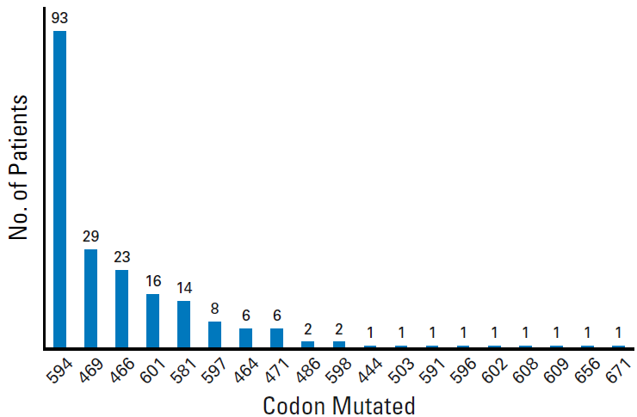
Database Analysis: Distribution of Non-V600 BRAF Mutations in Metastatic CRC
Jones. JCO. 2017;35:2624.
Slide credit: clinicaloptions.com
Notes:
CRC, colorectal cancer.

Slide 18
Database Analysis: OS by BRAF Mutation in mCRC
100
Median OS, Mos
BRAF V600E: 11.4
BRAF non-V600E: 60.7
BRAF wild type: 43.0
P < .001
75
Survival (%)
Non-V600
V600E
WT
50
25
0
0
50
100
150
Jones. JCO. 2017;35:2624.
Mos
Slide credit: clinicaloptions.com
Notes:
mCRC, metastatic colorectal cancer; WT, wild type.

Slide 19
BRAF Inhibitors in Metastatic CRC
Dabrafenib + trametinib + cetuximab or panitumumab
Vemurafenib + irinotecan +
cetuximab or panitumumab
Encorafenib + binimetinib + cetuximab or panitumumab
Guideline recommended for metastatic CRC with BRAF V600E after oxaliplatin- or irinotecan-based treatment
(not FDA indicated)
Guideline recommended for metastatic CRC with BRAF V600E after oxaliplatin- or irinotecan-based treatment
(not FDA indicated)
Guideline recommended for metastatic CRC with BRAF V600E after oxaliplatin- or irinotecan-based treatment
(not FDA indicated)
BEACON phase III trial recently met primary endpoint of ORR and OS in interim analysis
Slide credit: clinicaloptions.com
Notes:
CRC, colorectal cancer.

Slide 20
HER2

Slide 21
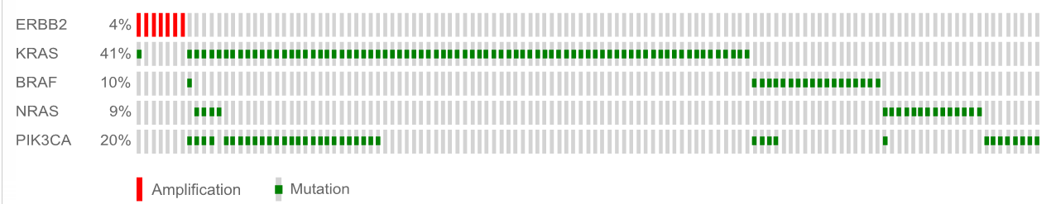
HER2 Amplification in Patients With Colorectal Cancer
HER2 overexpression and amplification is seen in a distinct subset of mCRC
Study | N | Positive Rate | IHC 2+ (Borderline) | IHC 3+ (Positive) | IHC/FISH Concordance
Nathanson^{[1]} | 139 | IHC: 5 (3.6%) FISH: 4 (2.4%) | 2 | 3 | K = 0.85
Ooi^{[2]} | 244 | IHC: 8 (3%) FISH: 8 (3%) | 2 | 6 | 100%
Marx^{[3]} | 1439 | IHC: 39 (3%) FISH: 36 (3%) | 12 | 27 | 100%
Summary | 1822 |  | 16 | 36 | Good
Unselected (n = 2349)
(patients)
KRAS wild type (n = 44)
(patients)
Quadruple negative (n = 11)
(xenopatients)
ERBB2 4%
KRAS 41%
2.7%
(2.5-3.7%)
13.6%
(P < .01%)
36.4%
(P < .001)
BRAF 10%
NRAS 9%
PIK3CA 20%
HER2 amplification
Amplification Mutation
5.3% HER2 amplification seen in HERACLES Study (screened = 836)^{[4]}
HER2 amplification enriched in KRAS, NRAS, BRAF, and PIK3CA WT tumors^{[5,6]}
1. Nathanson. Int J Cancer. 2003; 105:796. 2. Ooi. Mod Pathol. 2004;17:895 3. Marx. Human Path. 2010;41:1577.
4. Siena. ASCO 2015. Abstr TPS774. 5. Bertotti. 2011;1:508. 6. Kuwada. 2004;109:291.
Slide credit: clinicaloptions.com
Notes:
IHC, immunohistochemistry; WT, wild type.

Slide 22
HER2 Amplification in Colorectal Cancer
Resistance marker for EGFR antibodies
Defines patients who are candidates for HER2-targeted therapy
Slide credit: clinicaloptions.com

Slide 23
HERACLES: Trastuzumab + Lapatinib for Patients With Treatment Refractory KRAS WT/HER2+ mCRC
Multicenter, open-label phase II study
Primary endpoint: ORR (RECIST 1.1 by BICR)
Secondary endpoints: TTP, safety
Translational: HER2 ctDNA in plasma, HER2 ectodomain in serum, NGS in tissue and plasma in de novo resistant patients and upon PD
Patients with HER2+, KRAS exon 2 WT metastatic CRC not amenable to surgery;
PD on prior treatment with fluoropyrimidines, irinotecan, oxaliplatin, cetuximab, or panitumumab*; ECOG PS 0/1;
no CNS metastases
(N = 27)
Trastuzumab* 2 mg QW
+
Lapatinib 1000 mg QD
(n = 1420)
Progressive disease
*Loading dose 4 mg/kg IV
(Enrolled n=24; evaluable n=23)
*Bevacizumab, aflibercept or regorafenib allowed but not mandatory
Sartore-Bianchi. Lancet Oncol. 2016;17:738.
Slide credit: clinicaloptions.com
Notes:
BICR, blinded independent central review; CRC, colorectal cancer; ctDNA, circulating tumor DNA; ECOG, Eastern Cooperative Oncology Group; mCRC, metastatic colorectal cancer; NGS, next generation sequencing.

Slide 24
Trastuzumab + Lapatinib in KRAS WT/HER2+ mCRC (HERACLES): Response
Primary endpoint met in advance with 8/27 objective responses (as per protocol, 6/27 needed to declare the study positive)
Best Response (RECIST 1:1 BICR) | Number | %
Responses (PR + CR) | 8 | 30
CR | 1 | 4
PR | 7 | 26
Stable disease ≥ 4 mos | 8 | 30
Stable disease < 4 mos | 4 | 15
Progressive disease | 7 | 25
Total | 27 | 100
59% DCR
Sartore-Bianchi. Lancet Oncol. 2016;17:738.
Slide credit: clinicaloptions.com
Notes:
BICR, blinded independent central review; DCR, disease-control rate; mCRC, metastatic colorectal cancer; RECIST, response evaluation criteria in solid tumors; WT, wild type.

Slide 25
Thanks for listening

